Slide 1
Medcloud
22.04.2020

Slide 2
Part 1
About USMLE

Slide 3
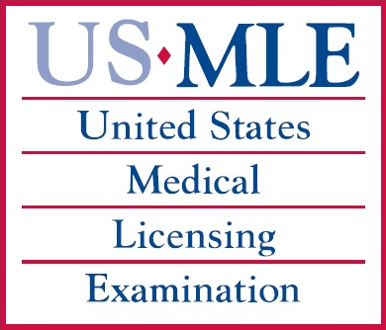
Что такое USMLE?
Почему именно USMLE?

Slide 4
USMLE является программой NBME* и FSMB**
*National Board Of Medical Examiners
**Federation of State Medical Boards

Slide 5
USMLE Steps
Step 1
Step 2CK
Step 2CS
Step 3
Embryo
Anatomy
Neuroscience
Physiology
Biochem
Microbiology
Immunology
Pharmacology
Pathology
Behavioral sc.
Internal med
Pediatrics
Psychiatry
Behavioral sc.
Ob/Gyn
Surgery
Simulation
Medical knowledge
Simulation

Slide 6
USMLE Step 1
One-day exam
Divided into seven 60-minute blocks and administered in one 8-hour testing session.
The number of questions per block on a given examination form may vary, but will not exceed 40.
The total number of items on the overall examination form will not exceed 280
Source: https://www.usmle.org/step-1/

Slide 7
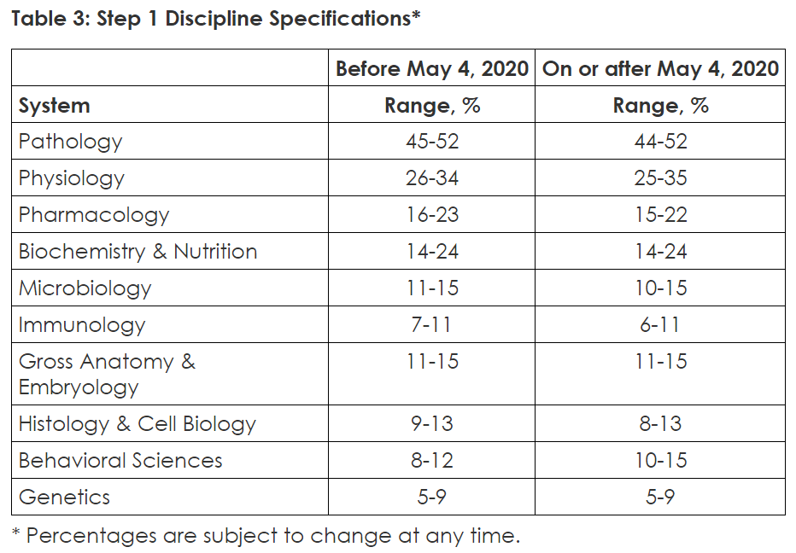
USMLE Step 1
Content
Source: https://www.usmle.org/step-1/

Slide 8
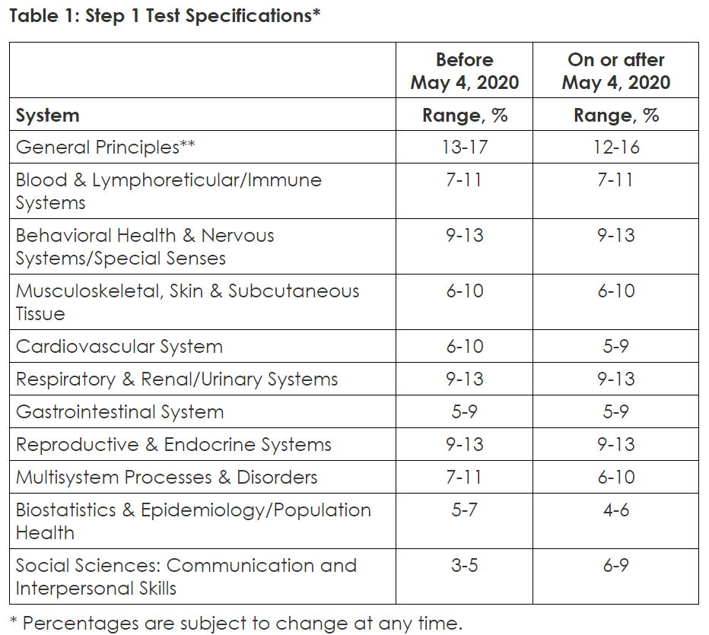
USMLE Step 1
Content
Source: https://www.usmle.org/step-1/

Slide 9
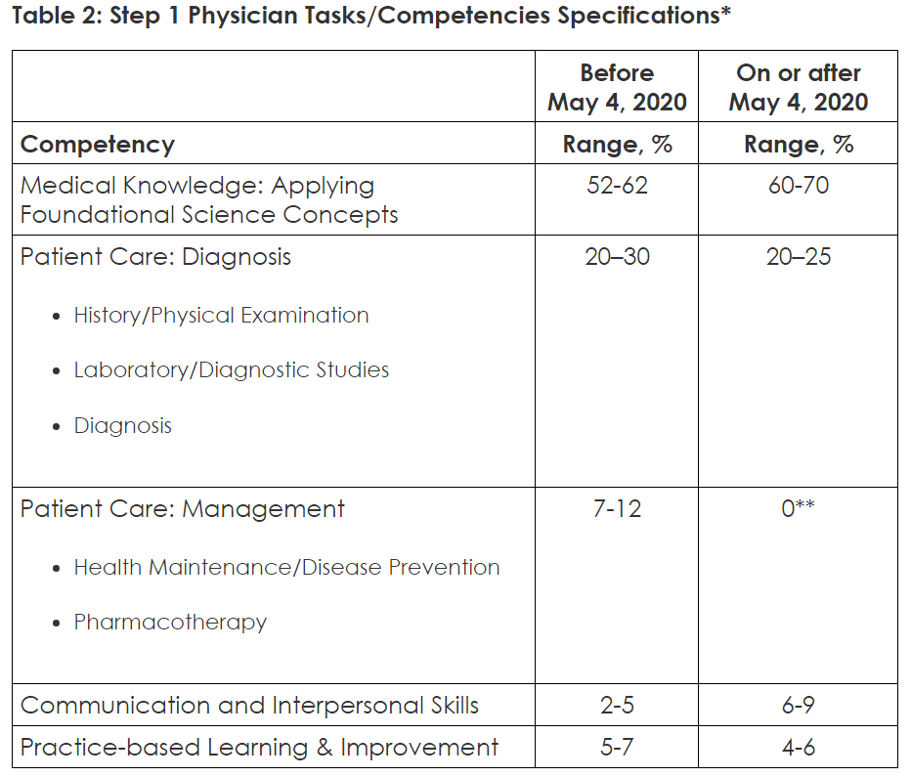
USMLE Step 1
Content
Source: https://www.usmle.org/step-1/

Slide 10
USMLE Step 1
Content
Example Item
A 32-year-old woman with type 1 diabetes mellitus has had progressive renal failure over the past 2 years. She has not yet started dialysis. Examination shows no abnormalities. Her hemoglobin concentration is 9 g/dL, hematocrit is 28%, and mean corpuscular volume is 94 m3. A blood smear shows normochromic, normocytic cells. Which of the following is the most likely cause?
Acute blood loss
Chronic lymphocytic leukemia
Erythrocyte enzyme deficiency
Erythropoietin deficiency
Immunohemolysis
Microangiopathic hemolysis
Polycythemia vera
Sickle cell disease
Sideroblastic anemia
β-Thalassemia trait
Source: https://www.usmle.org/step-1/

Slide 11
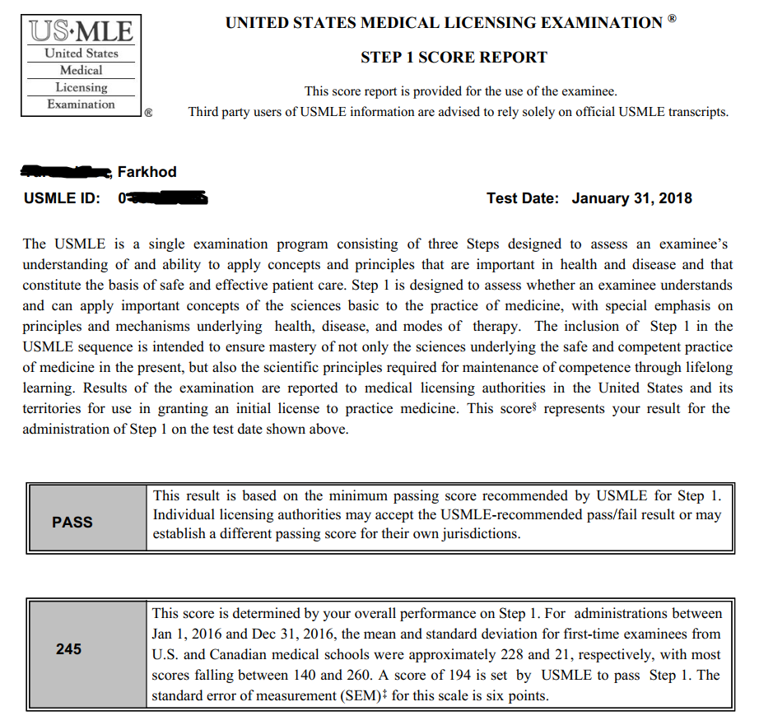
USMLE Step 1
Score Report

Slide 12
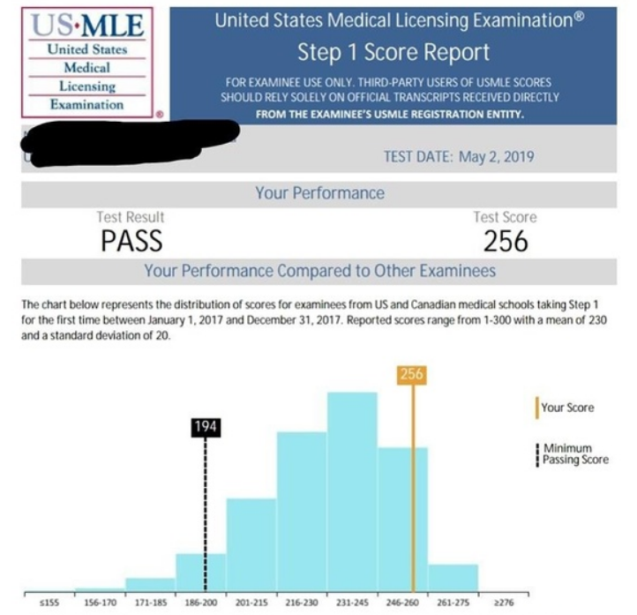
USMLE Step 1
Score Report

Slide 13
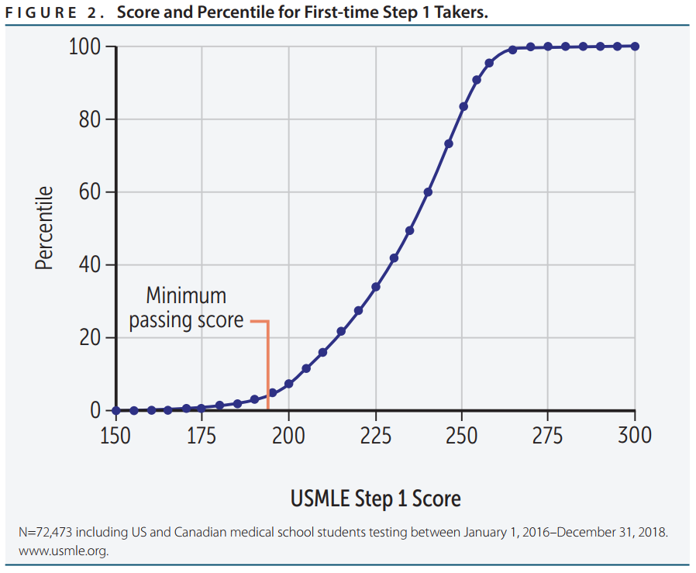
USMLE Step 1
Scoring
Source: First Aid for the USMLE step 1

Slide 14
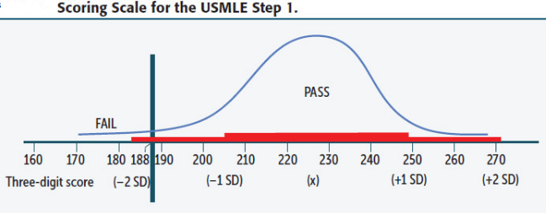
USMLE Step 1
Scoring
Source: First Aid for the USMLE step 1

Slide 15
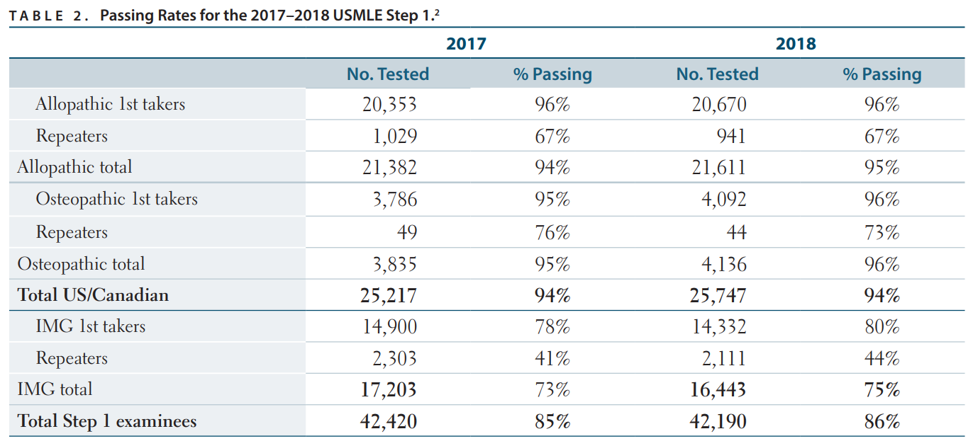
USMLE Step 1 Scoring
Source: First Aid for the USMLE step 1

Slide 16
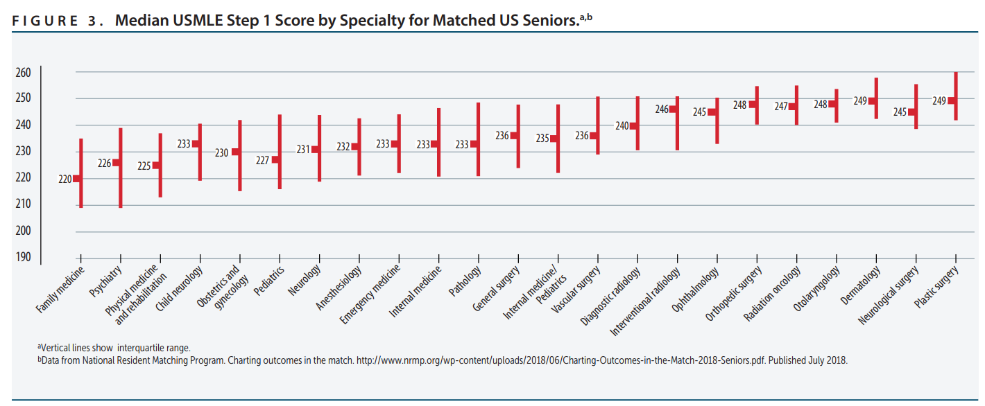
USMLE Step 1 Scoring
Source: First Aid for the USMLE step 1

Slide 17
USMLE Step 1 News
On February 12, 2020, the Federation of State Medical Boards (FSMB) and the National Board of Medical Examiners (NBME) announced the following policy changes:
USMLE Step 1 will be a pass/fail exam
The number of exam attempts is reduced from six to four
All examinees must pass Step 1 before taking Step 2 Clinical Skills (CS).
Source: https://www.forbes.com/

Slide 18
Q’s about Step 1?

Slide 19
USMLE Step 2 CK
One-day exam.
Divided into eight 60-minute blocks and administered in one 9-hour testing session.
The number of questions per block on a given examination will vary but will not exceed 40.
The total number of items on the overall examination will not exceed 318.
Source: https://www.usmle.org/step-2-ck/

Slide 20
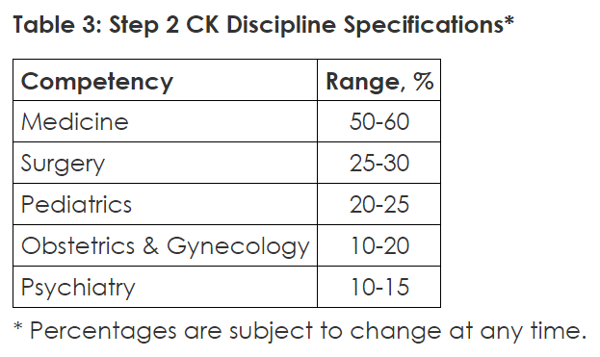
USMLE Step 2 CK
Content
Source: https://www.usmle.org/step-2-ck/

Slide 21
USMLE Step 2 CK
Content
Source: https://www.usmle.org/step-2-ck/

Slide 22
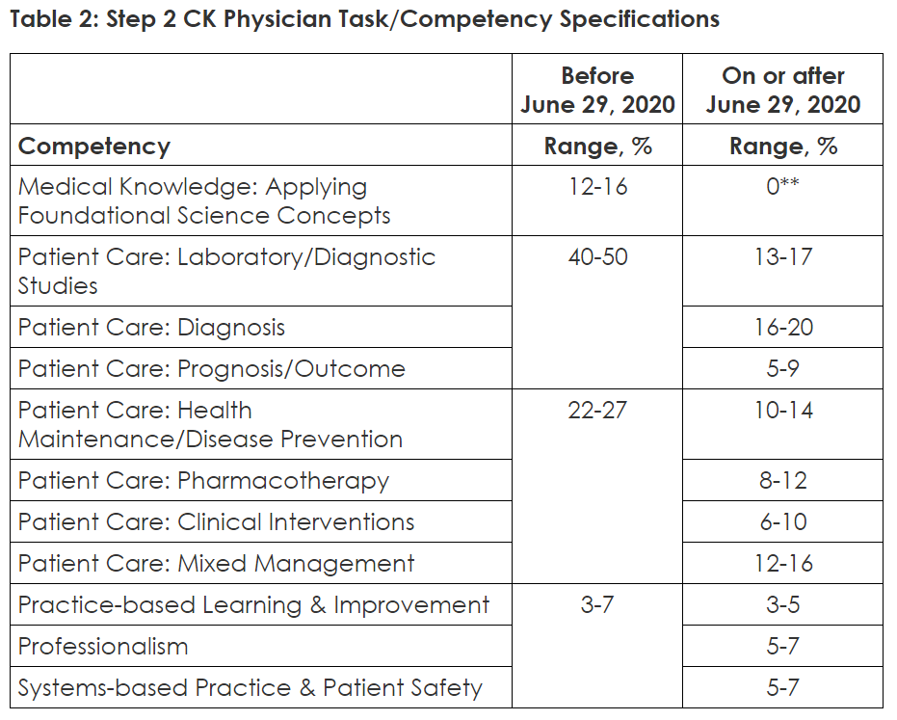
USMLE Step 2 CK
Content
Source: https://www.usmle.org/step-2-ck/

Slide 23
USMLE Step 2 CK
Content
A 67-year-old man with type 2 diabetes mellitus, intermittent claudication of the lower extremities bilaterally, and a 25-pack-year history of smoking presents to the emergency department with crushing substernal chest pain at rest. He has experienced exertional angina for the past 6 months, but his current pain arose spontaneously this morning. It was unrelieved by rest and only mildly helped by sublingual nitroglycerin. At the time of examination, the pain has passed and he is hemodynamically stable. He is admitted for observation and undergoes cardiac catheterization the following morning, which reveals a 78% stenosis of the left main artery, with minimal other disease. The patient is otherwise healthy. He wishes for the treatment most likely to increase his survival.
Which of the following is most appropriate for this patient at this time?
A. Angioplasty with placement of a stent
B. Angioplasty without placement of a stent
C. Coronary artery bypass grafting
D. Heart transplant
E. Medical management without invasive therapy
F. Thrombolytic therapy
Source: usmle-rx.com

Slide 24
USMLE Step 2 CK
Content
Explanation
Coronary artery bypass grafting (CABG) has been shown to have a survival advantage in patients with:
1. 50% or greater stenosis of the left main artery
2. Three-vessel disease or two-vessel disease if there is a large area of viable myocardium in high-risk area
3. 70% of proximal LAD with either ejection fraction less than 50% or ischemia demonstrable in noninvasive testing
4. Stenosis of proximal LAD and proximal circumflex more than 70%
This patient's 78% stenosis of the left main artery and his history of exertional angina make him a candidate for CABG. His overall good health preempts any other possible contraindications to the surgery.
Source: usmle-rx.com

Slide 25
Q’s about Step 2 CK?

Slide 26
USMLE Step 2 Clinical Skills
Your Step 2 CS administration will include twelve patient encounters.
You will have 15 minutes for each.
Source: https://www.usmle.org/step-2-cs/

Slide 27
Expenditures
Step 1 - $2500
Step 2 CK - $2500
Step 2 CS – $3500-4500

Slide 28
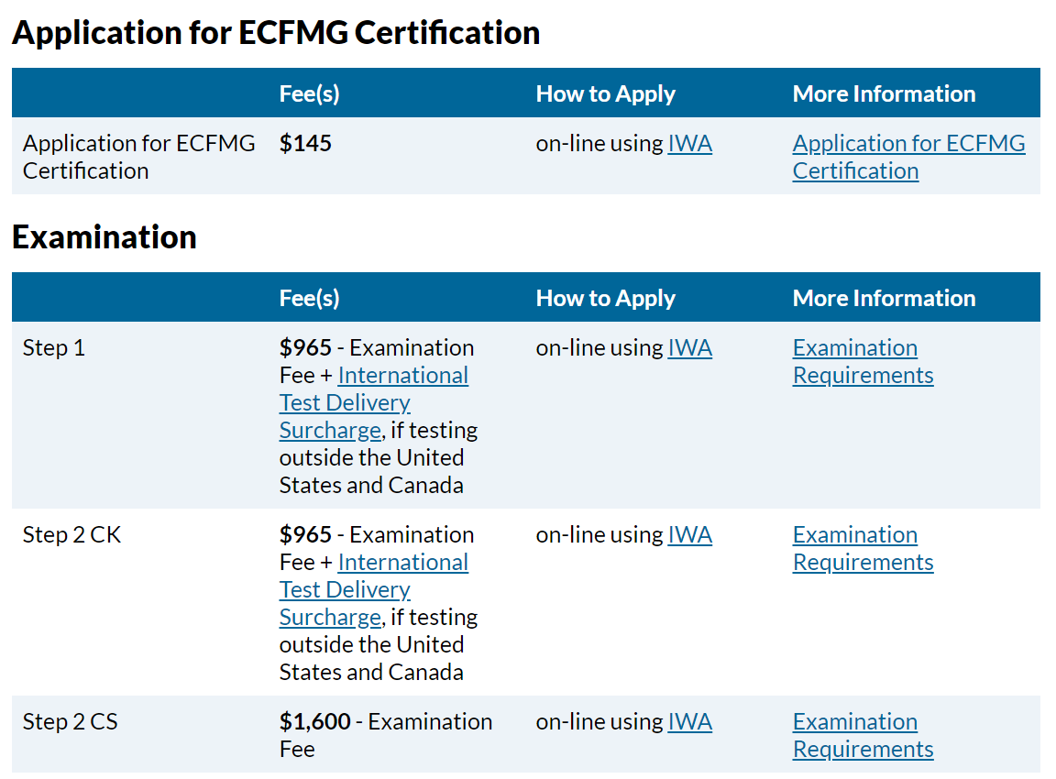
Expenditures
Source: https://www.ecfmg.org/fees

Slide 29
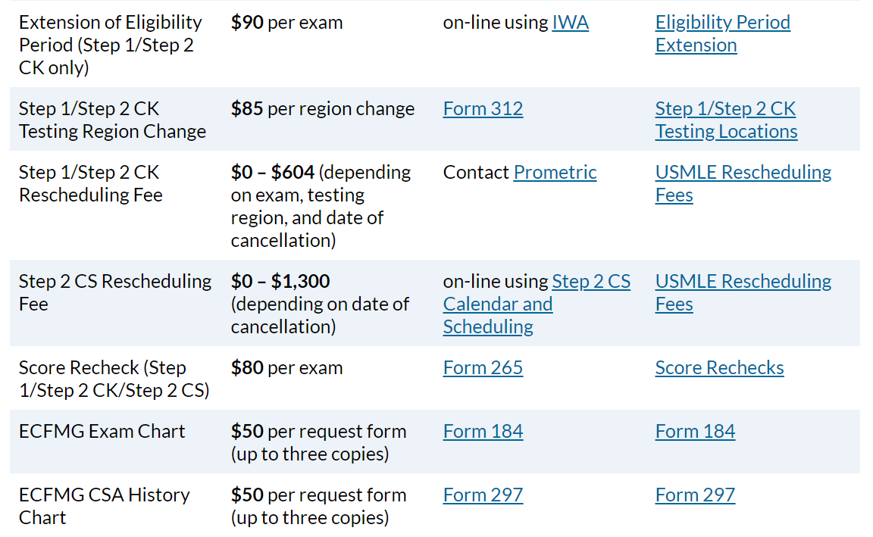
Expenditures
Source: https://www.ecfmg.org/fees

Slide 30
Гранты на образование

Slide 31
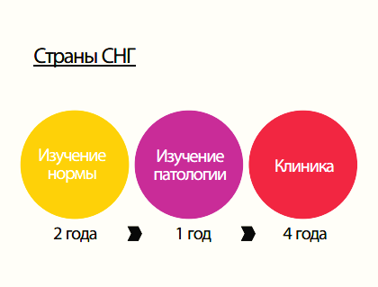
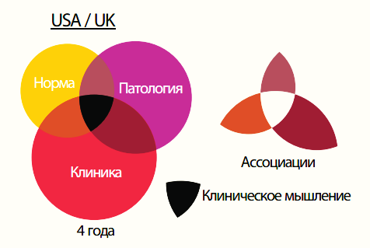
Подход в обучении

Slide 32
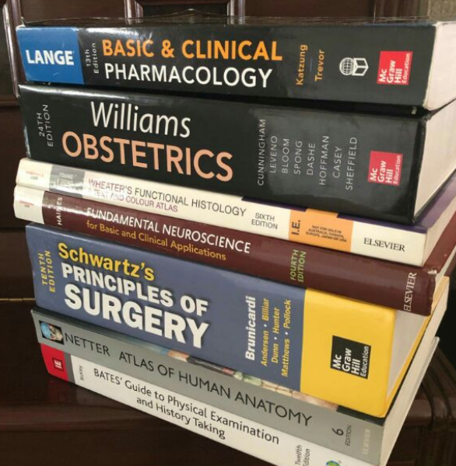
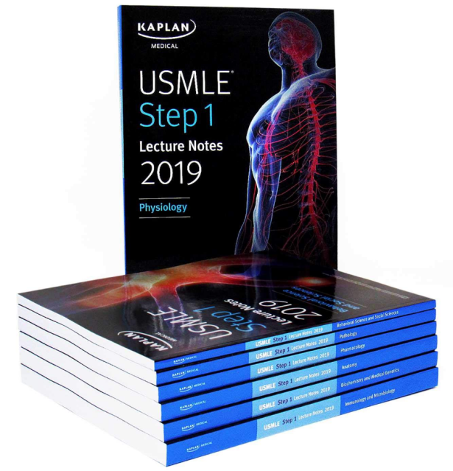
Study Materials
Reference books vs Review books

Slide 33
My Story
First books
My english
Difficulties
Financial problems
Last 2 months

Slide 34
My Story: Materials used
Kaplan
(except Micro and pathology)
BRS (Board Review Series): Physiology, Behave, Embryo
High–Yield series:
Cell and molecular biology, Embryology, Neuroanatomy, Gross anatomy
100 Cases by Fischer
MRS Microbiology
Pathology:
Goljan, Pathoma
First Aid for the USMLE Step 1 2017/2018

Slide 35
My Story: Performance
Usmle-Rx Qmax – 80%
Uworld – 76%
NBME 17 – 235 (1 month)
NBME 18 – 224 (2 days)
Exam - 245

Slide 36
My Story: Additional Materials
Acland’s Video Atlas
Amboss.com
BRS series
Google.com

Slide 37
Q’s?

Slide 38
Part 2.
Effective learning techniques

Slide 39
Цели и принятие решения

Slide 40
Социальные сети

Slide 41
Влияние окружающих

Slide 42
Понятие «эффективная подготовка»

Slide 43
Творческий подход

Slide 44
Человек vs Врач

Slide 45
Think and Act table
Act
Think

Slide 46
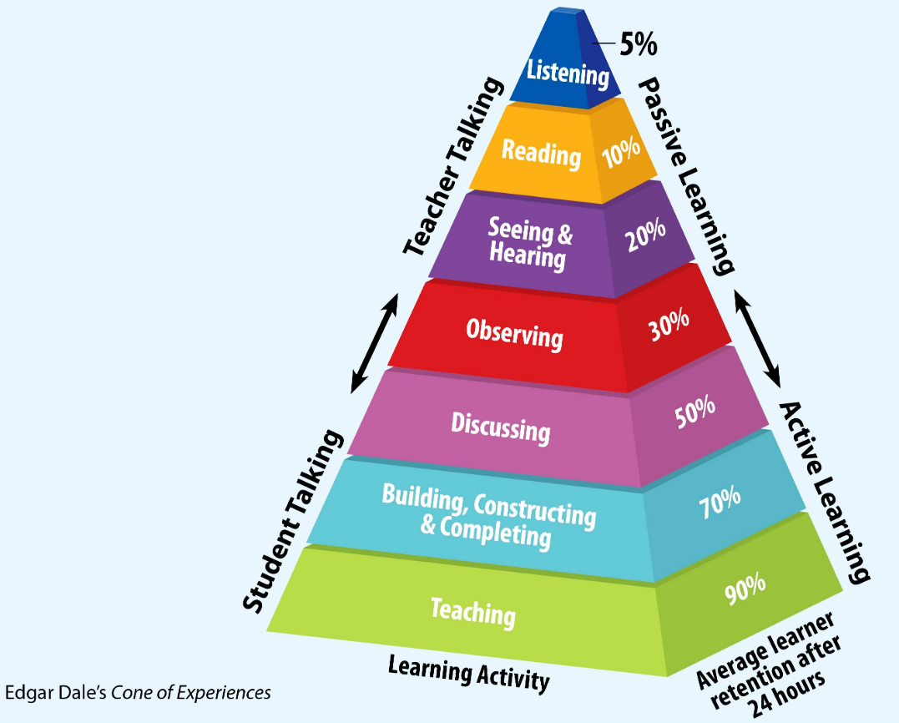
Cone of
learning

Slide 47
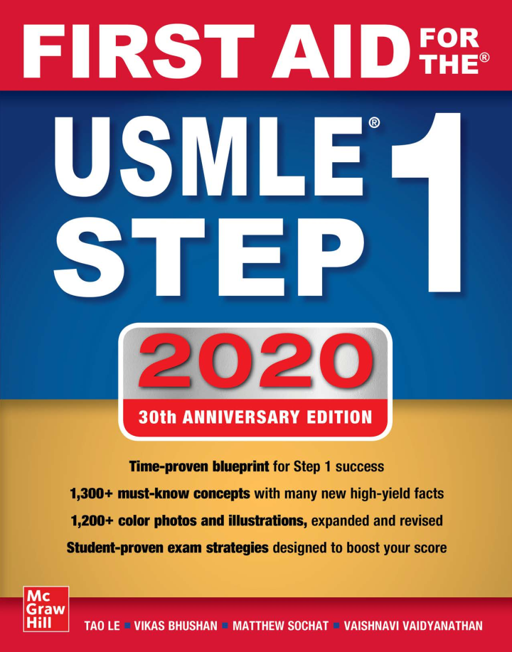
Each discipline

Slide 48
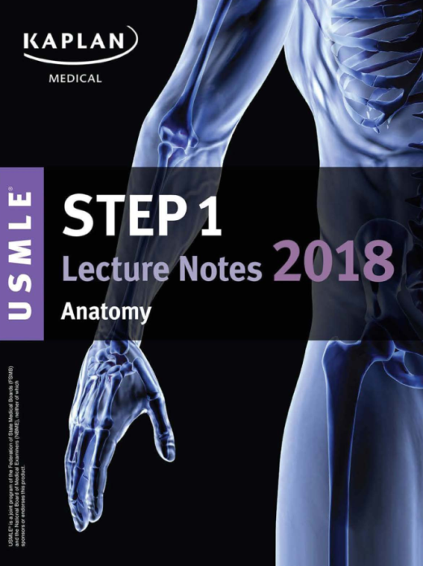
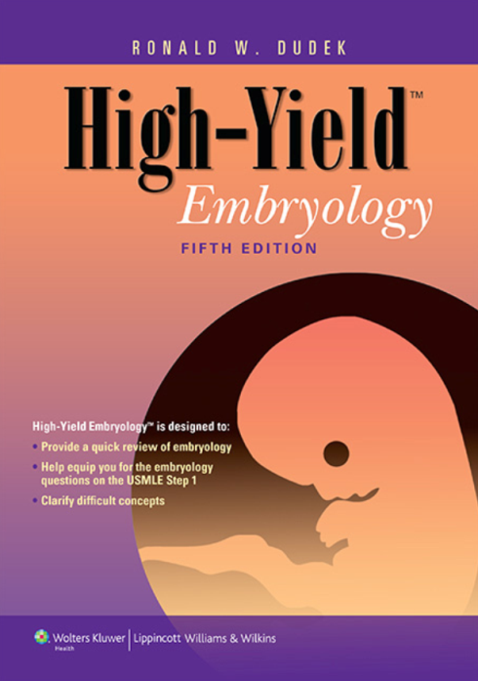
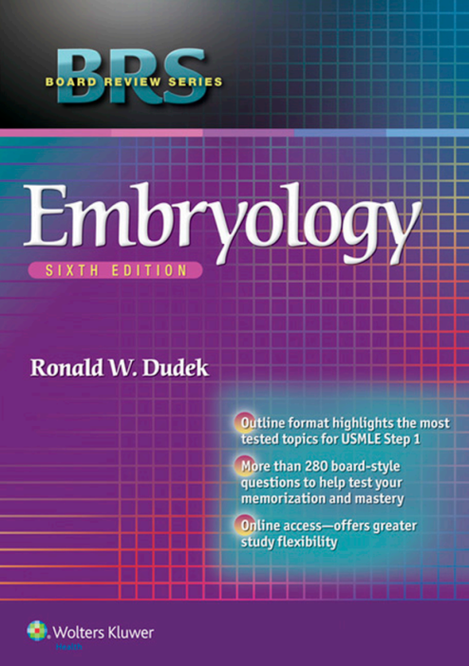
Embryology

Slide 49
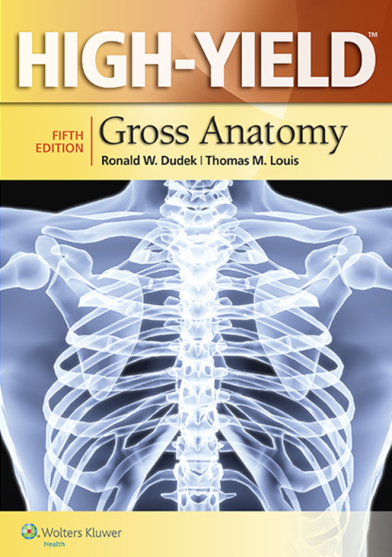
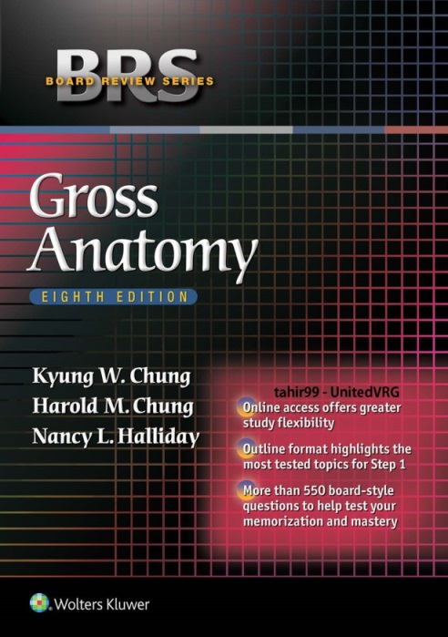
Gross Anatomy

Slide 50
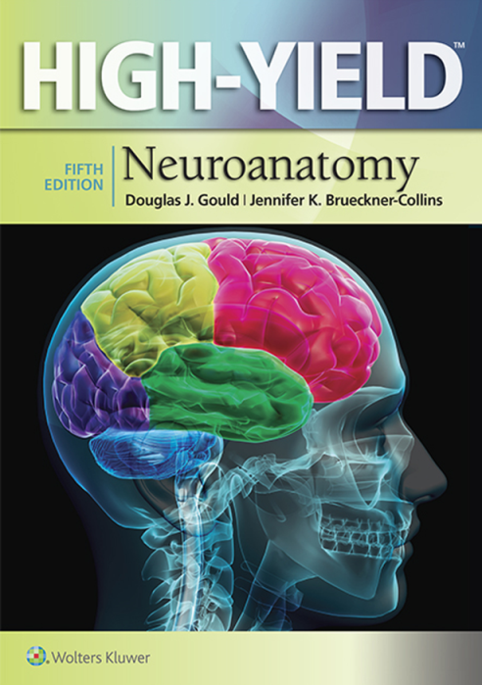
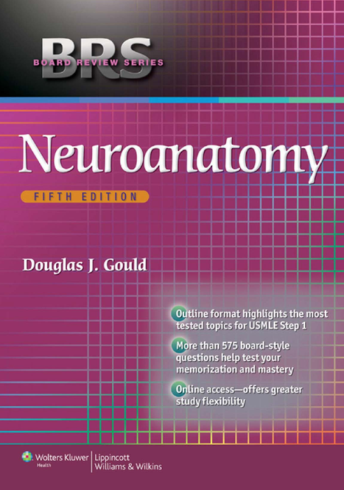
Neuroanatomy

Slide 51
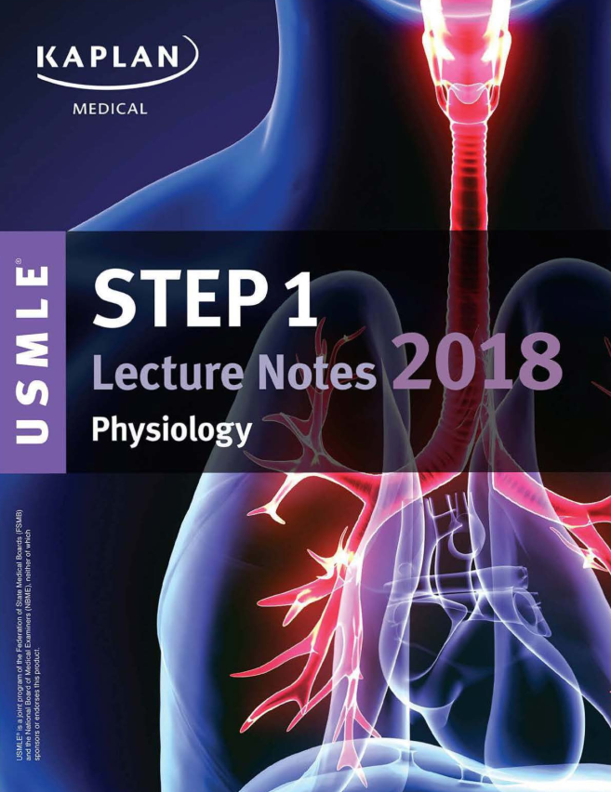
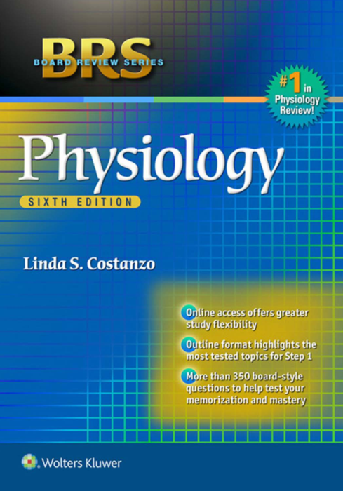
Physiology

Slide 52
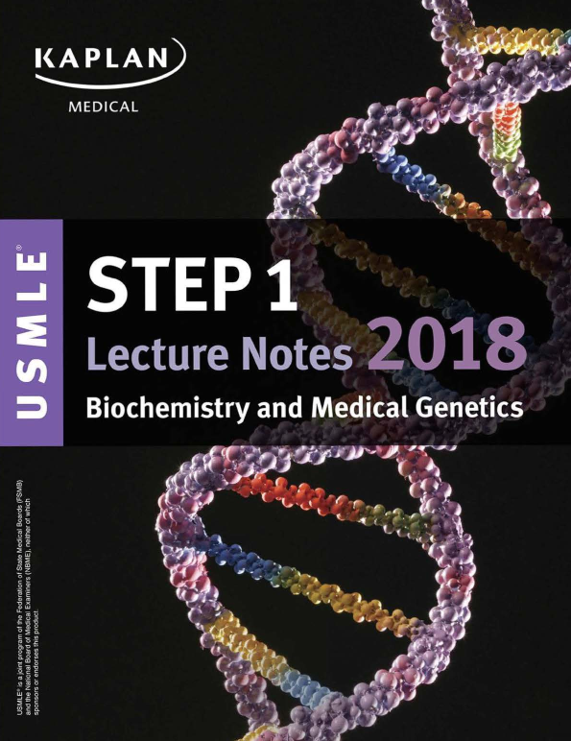
Biochem

Slide 53
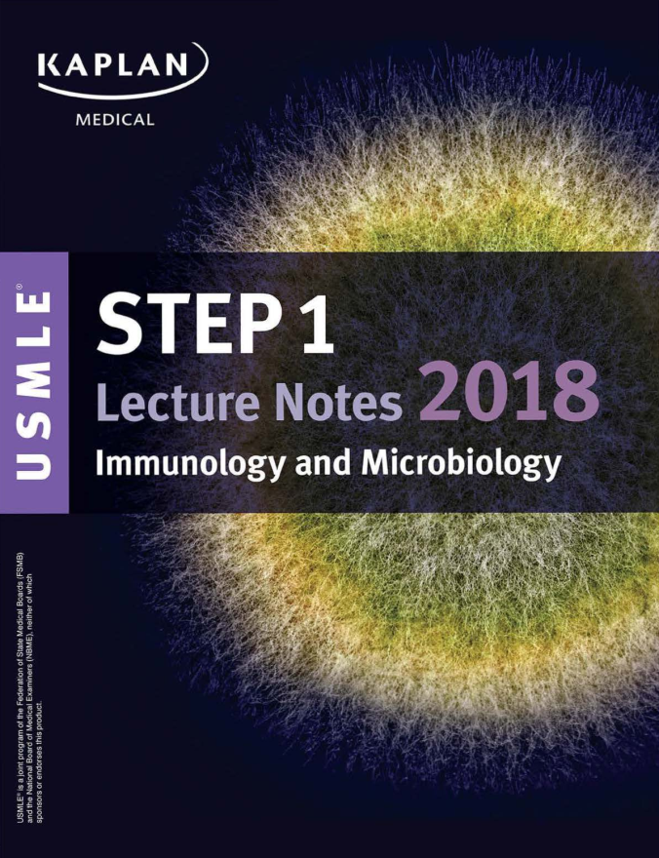
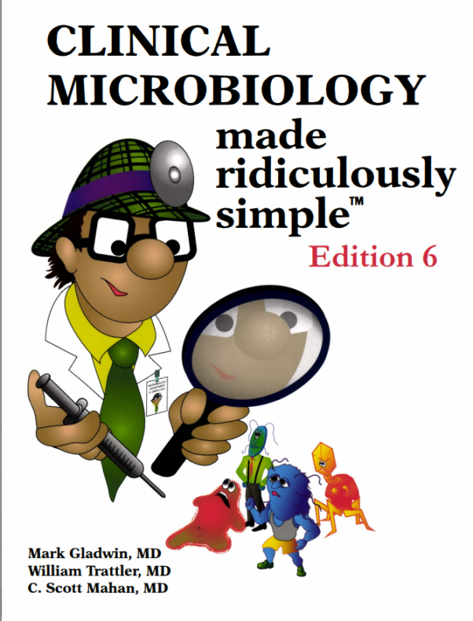
Micro and Immuno

Slide 54
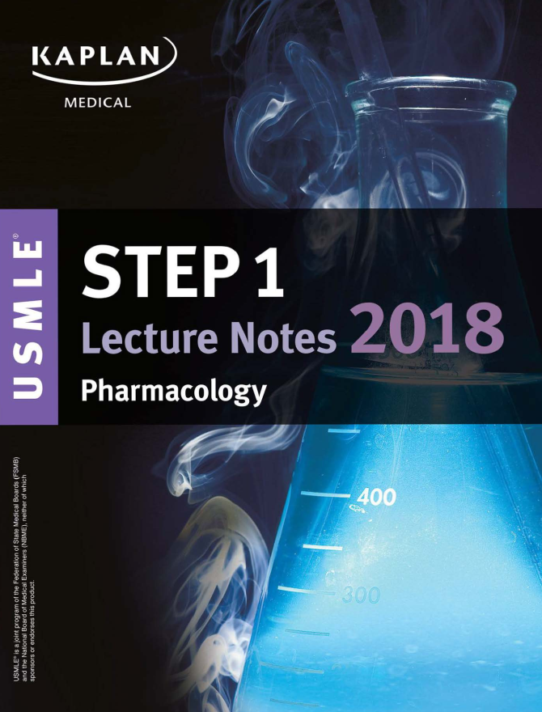
Pharm

Slide 55
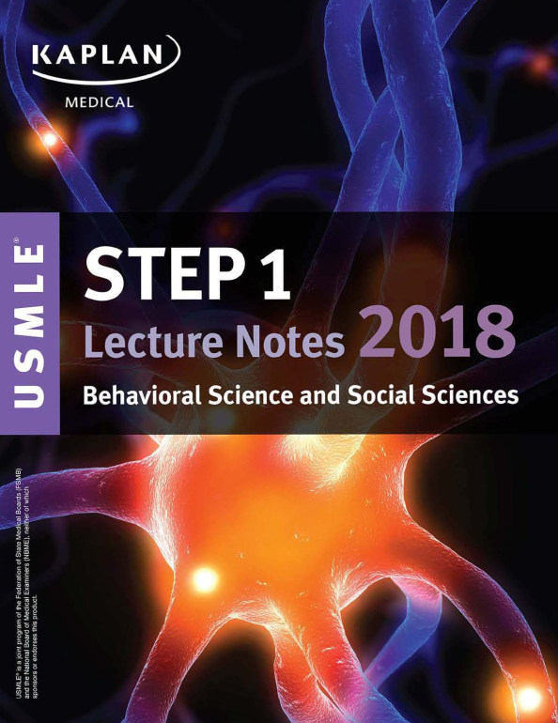
Behavioral scienes

Slide 56
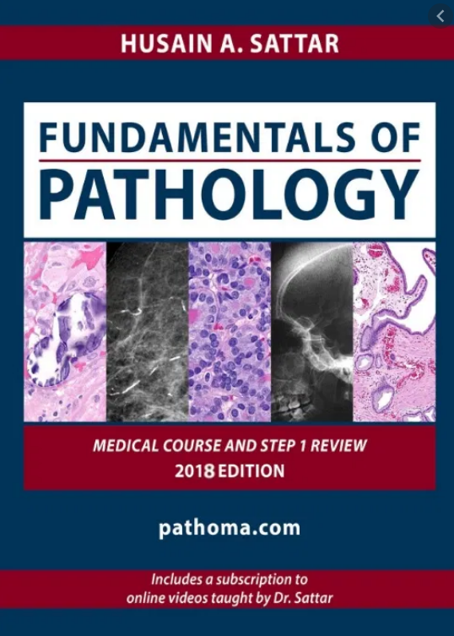
Pathology

Slide 57
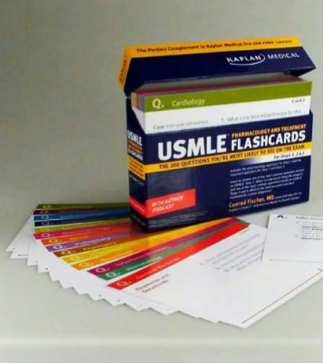
Flash cards
Anki droid
Chegg

Slide 58
Qbanks
Usmle-rx.com
Amboss.com
Uworld.com

Slide 59
NBME Self Assessment
www.mynbme.org

Slide 60
Sherlock’s Principle

Slide 61
Conclusion

Slide 62
Q and A

